Slide 1
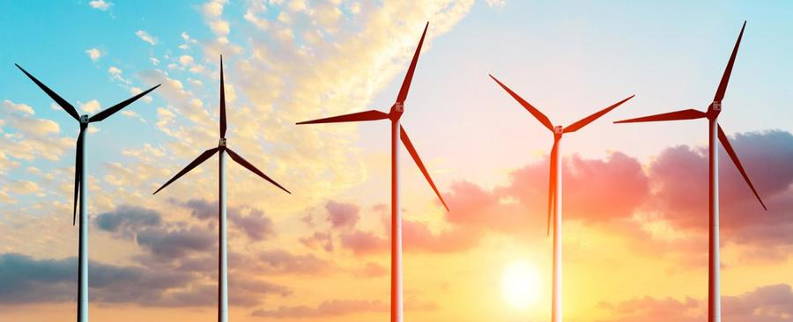
Externalities
and Public Goods
Notes:
http://www.slate.com/articles/business/the_juice/2015/09/texas_electricity_goes_negative_wind_power_was_so_plentiful_one_night_that.html?wpsrc=sh_all_dt_tw_bot

Slide 2
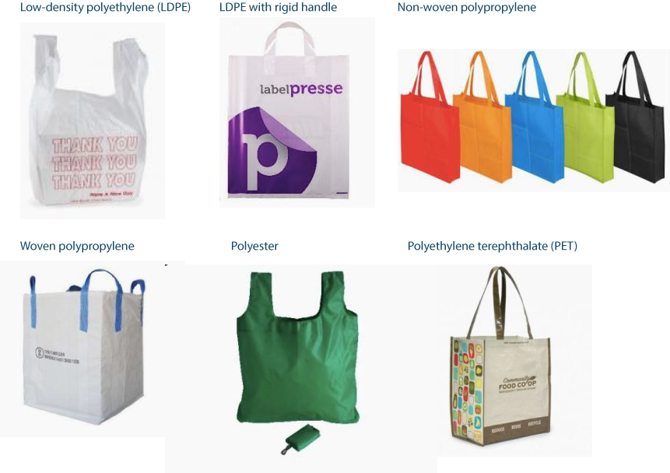


Plastic v. Paper or Cotton?
Paper Bag
2
52
43
Cotton
45
35
85
131+

Slide 3
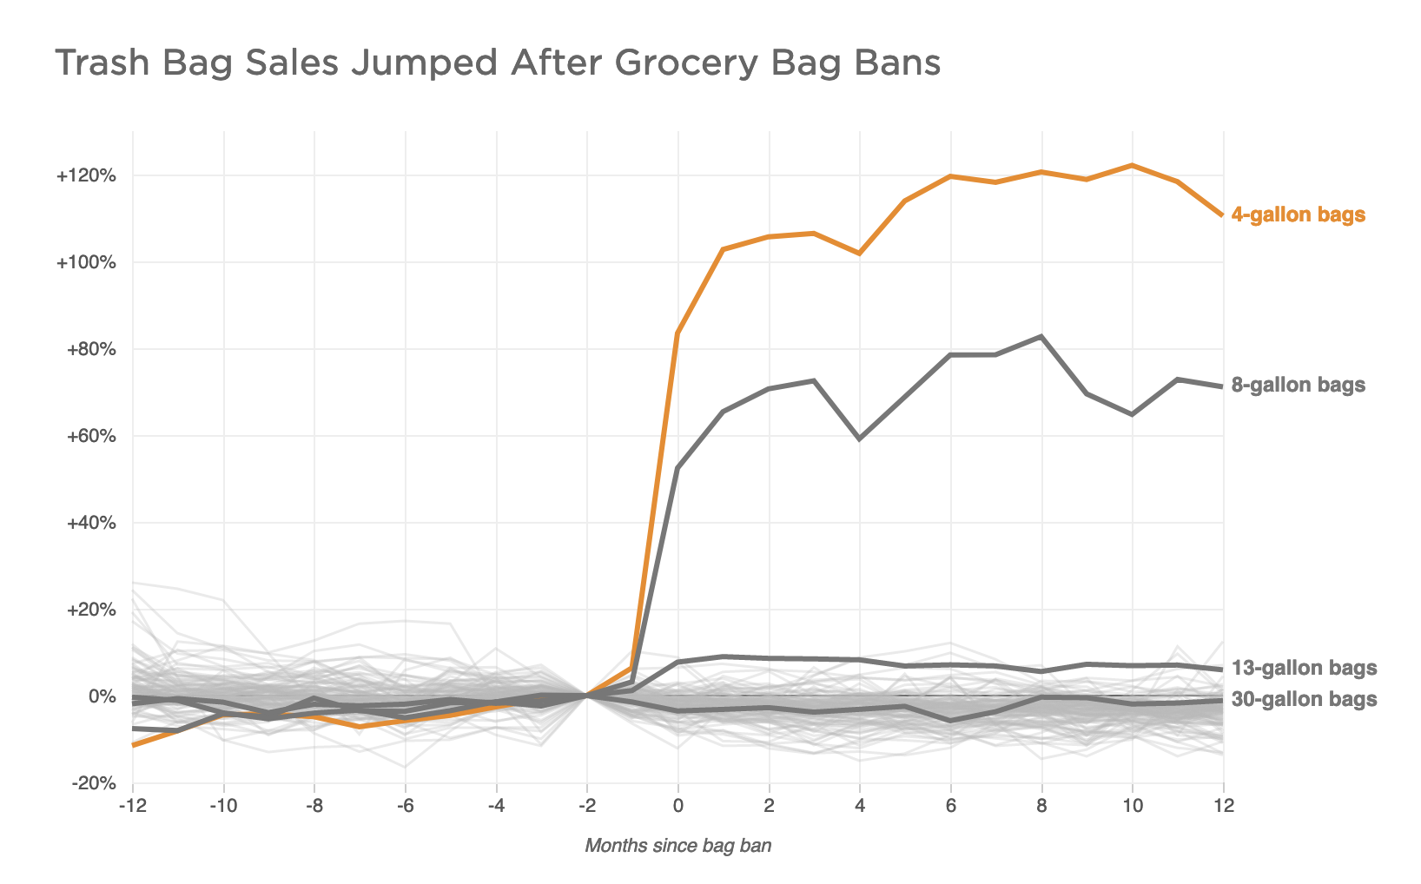

Slide 4
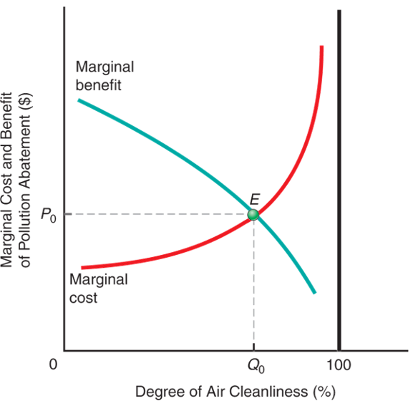
What is the optimal amount of pollution?
!
It’s NOT zero.
!
The optimal quantity of pollution occurs where MC = MB.

Slide 5
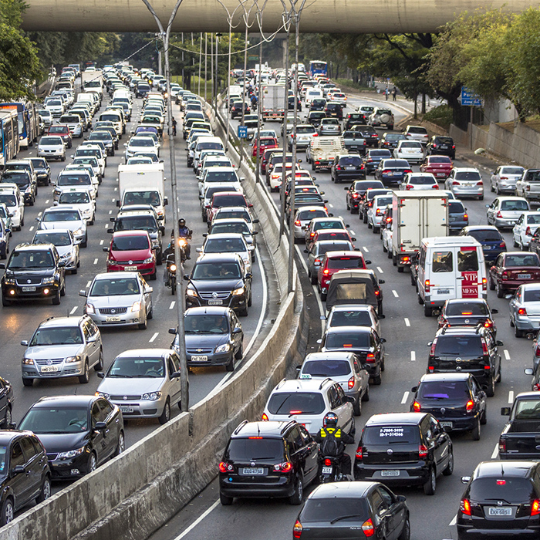
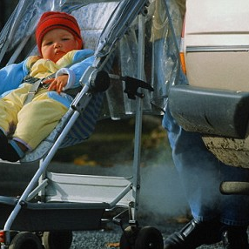
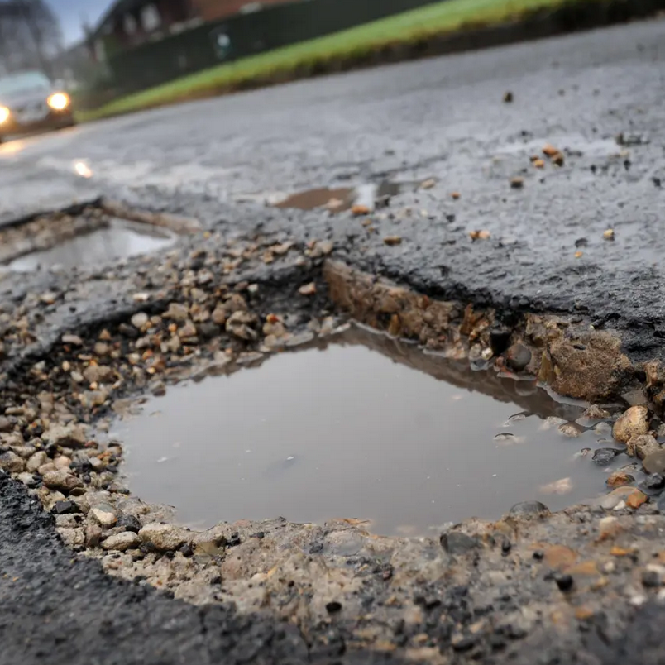
Externalities
When social benefits/costs differ from the private benefits/costs, externalities create a third party problem.
TPS: How would you alter your demand if you had to pay the social cost of driving a car?

Slide 6
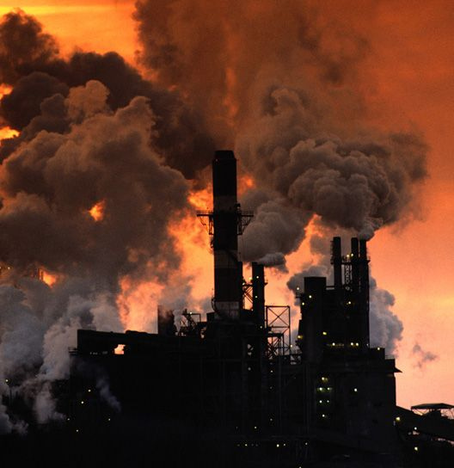
Market failure: the market has not allocated resources efficiently-agents do not take into account the externality when deciding how much to produce and/or consume.
Need to internalize the external cost to get to the efficient allocation.

Slide 7
Correcting Negative Externalities
Regulations
Taxes
Private negotiation

Slide 8
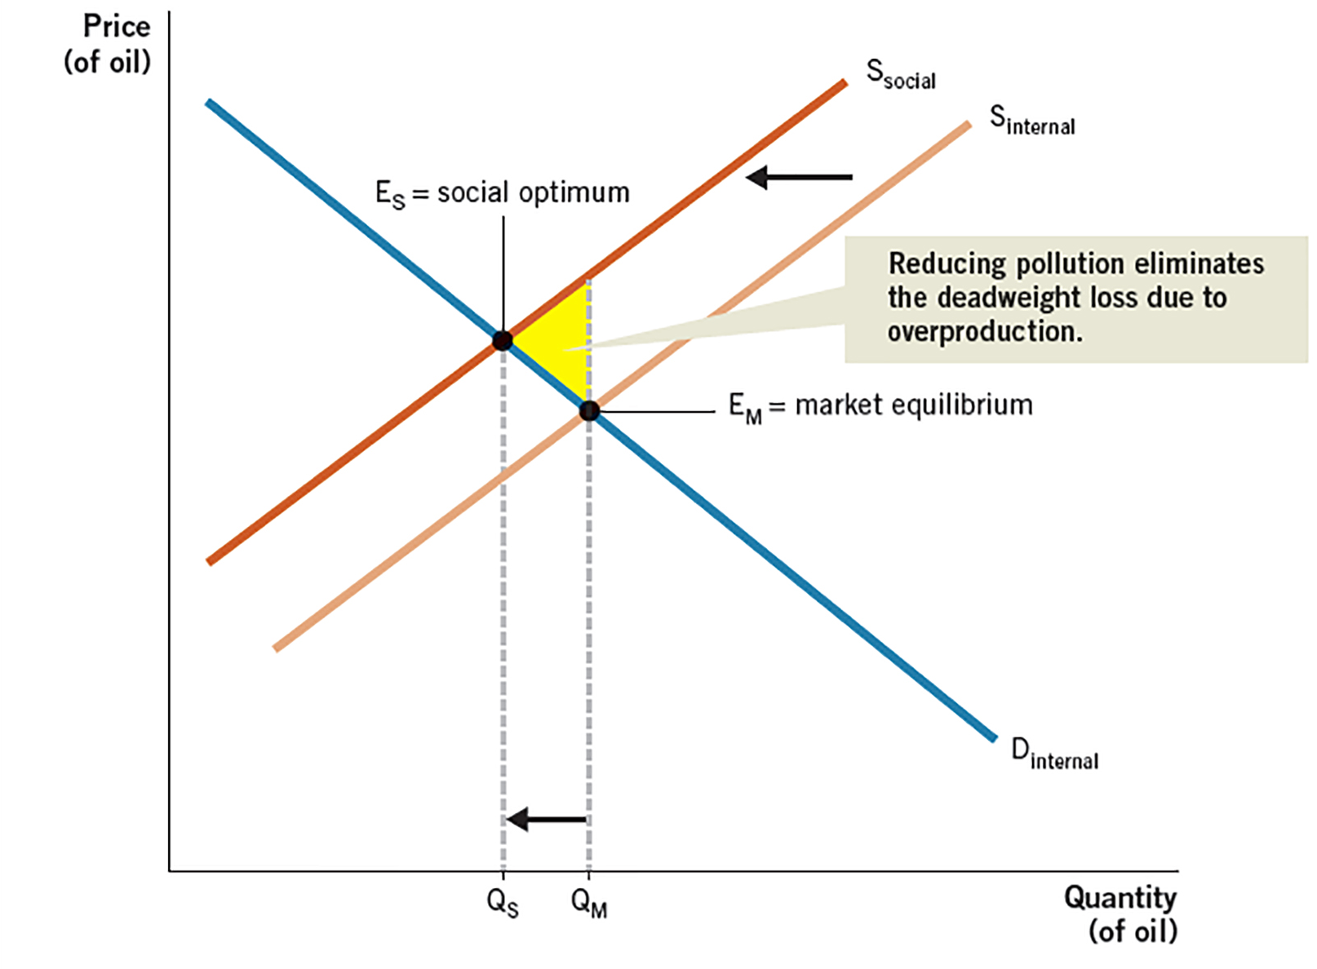
Correcting Negative Externalities
TAX
Market Q: Too high
Market P:
Too low
P_{S}
P_{M}

Slide 9
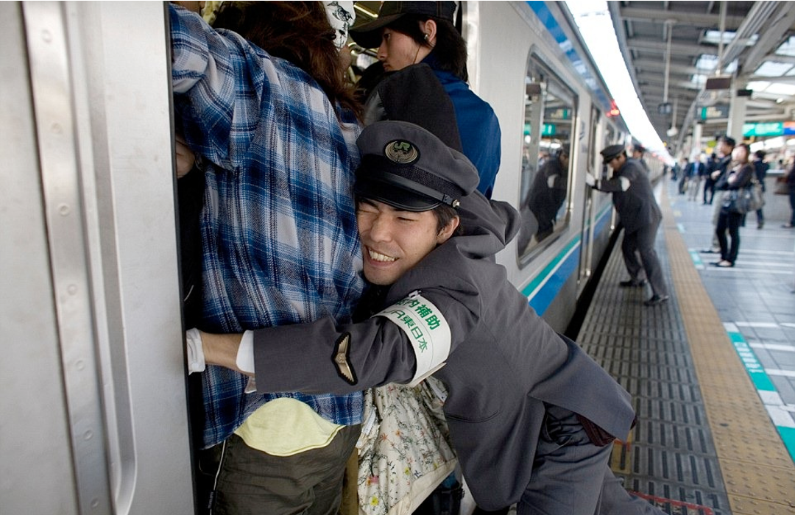
Congestion on Public Transport

Slide 10
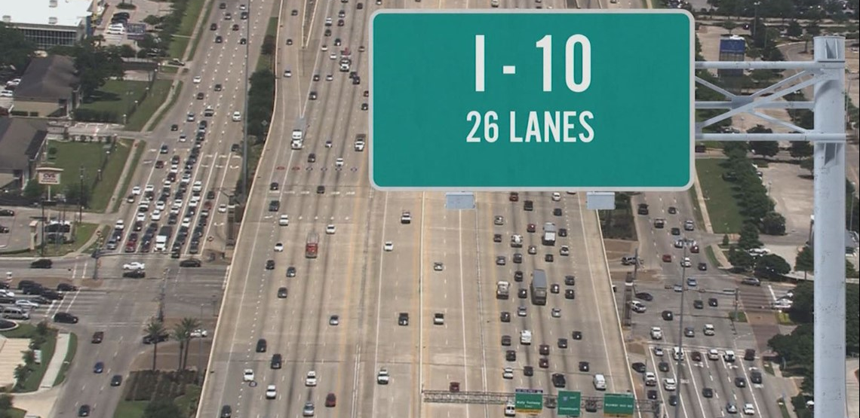

Slide 11
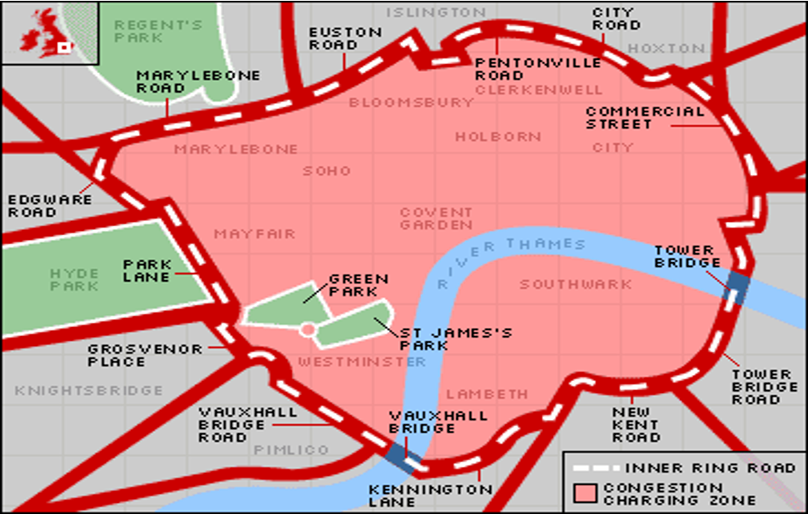
London Congestion Tax

Slide 12
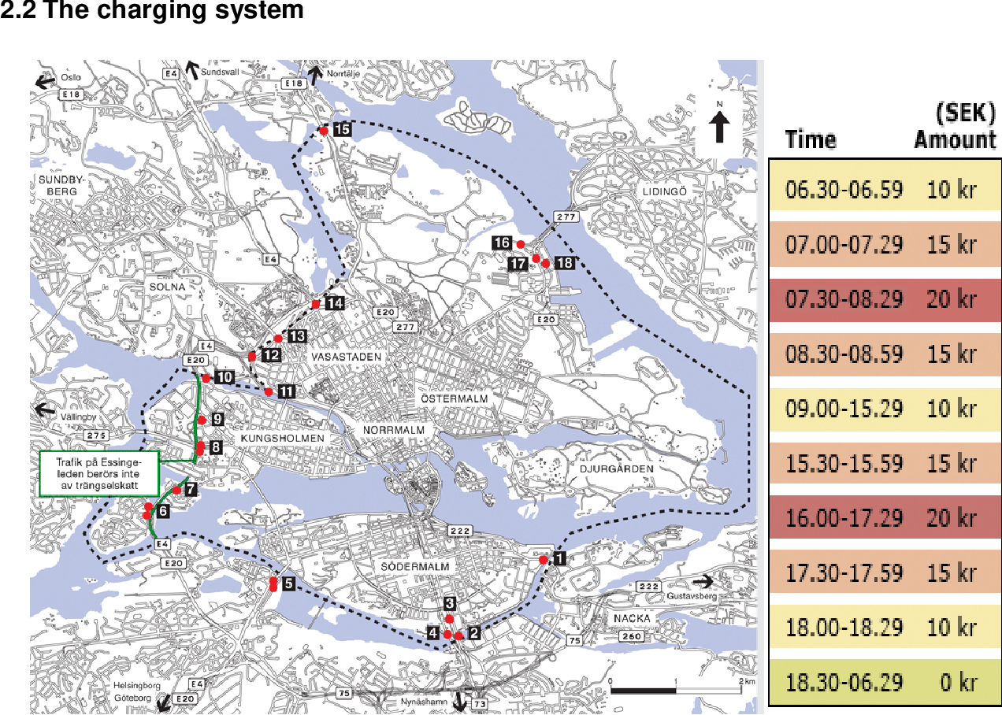
Stockholm Congestion Tax

Slide 13
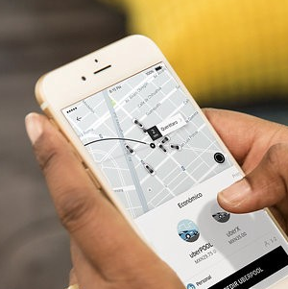
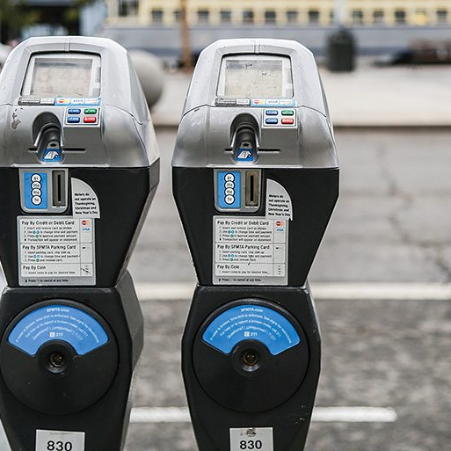
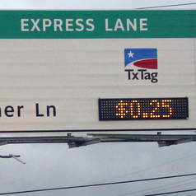
Dynamic Pricing
allows the price to vary with supply and demand
Ride sharing
Smart parking meters
Toll Lanes

Slide 14

Enhancing Positive Externalities
Subsidies
Other incentives
Private institutions

Slide 15
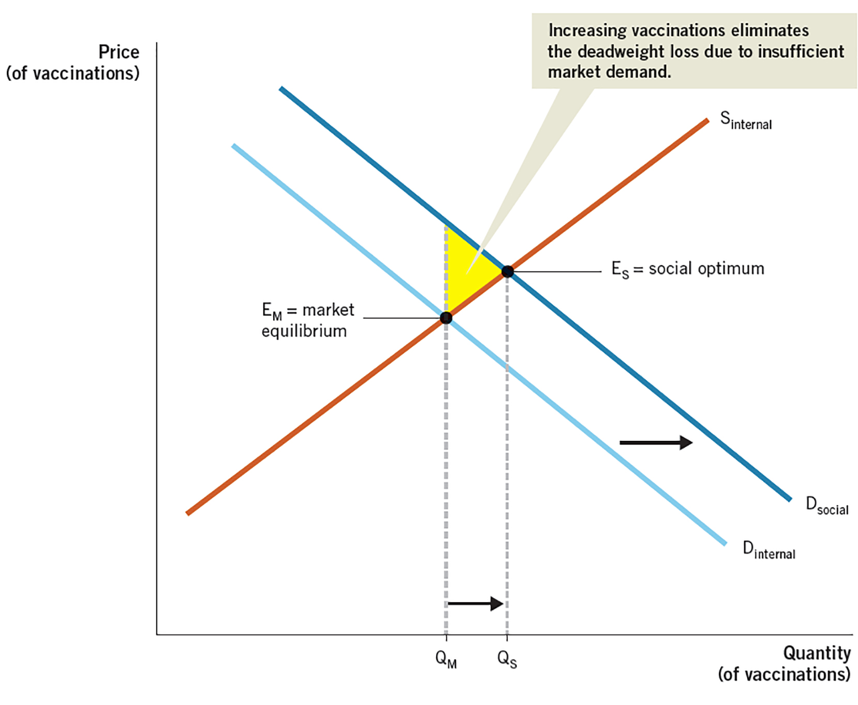
Enhancing Positive Externalities
Subsidy

Slide 16
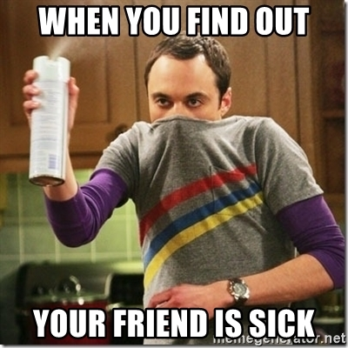


Three Types of Externalities
Negative Externality
Positive Externality
Negligible Externality
Market Q is more than socially desirable
Market Q is less than socially desirable
Market Q is close to socially desirable

Slide 17
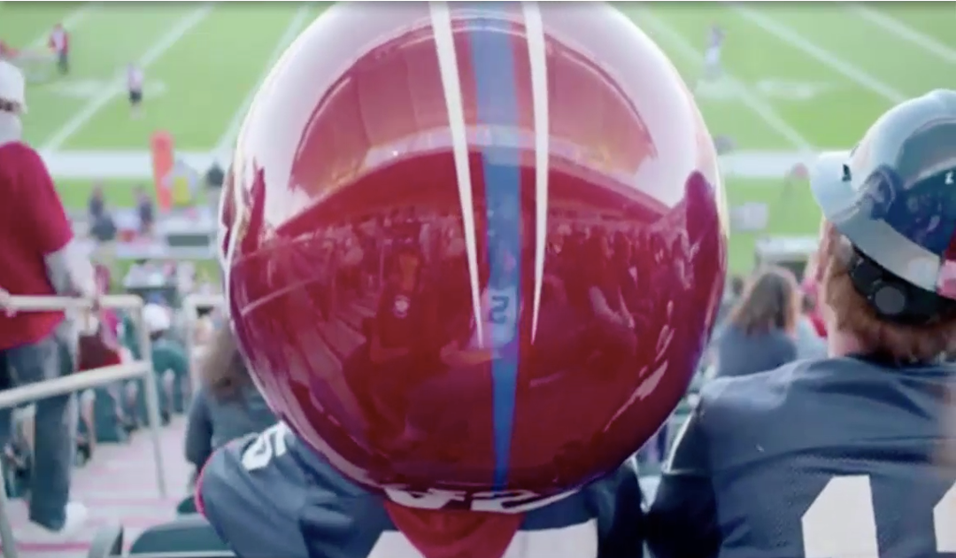
The Coase Theorem
Can private parties solve the externality problem?

Slide 18
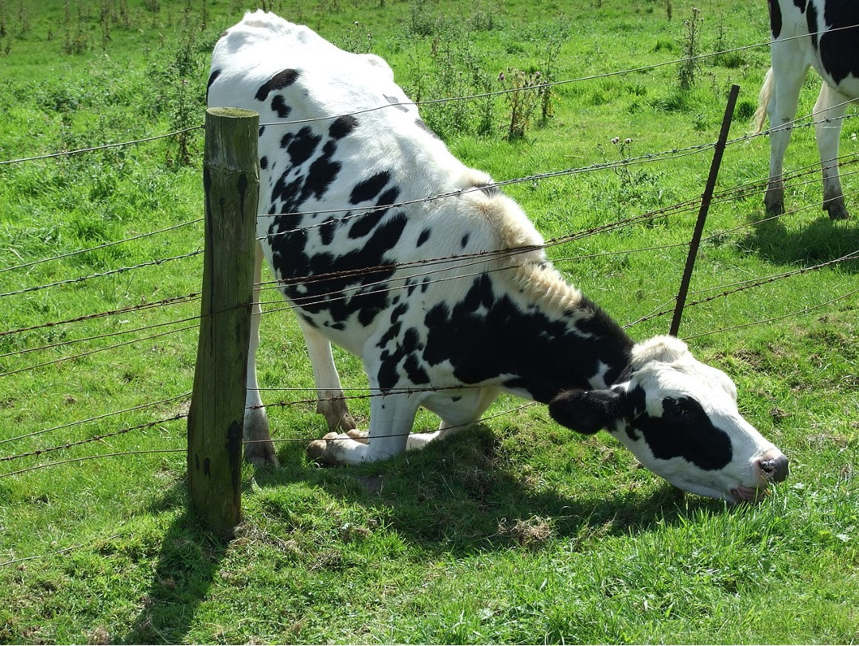
This fence is designed to keep the cows away from the adjacent pasture. Who will build the fence, the cattle rancher or the farmer nearby?
The Coase Theorem states that where there are no transactions costs, any externalities will be internalized, regardless of how property rights are divided.

Slide 19
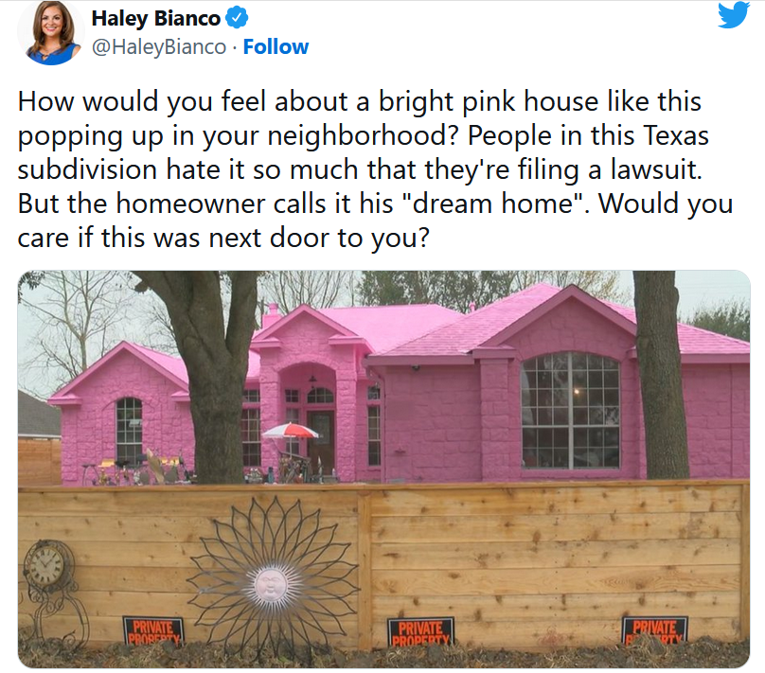

Slide 20


Eleven Madison Park uses cell phone boxes to internalize the externality.
The most important invention you’ve never heard about!
In Australia, smoking is banned inside. Where allowed by law, smokers are sent outside to externalize the externality.

Slide 21
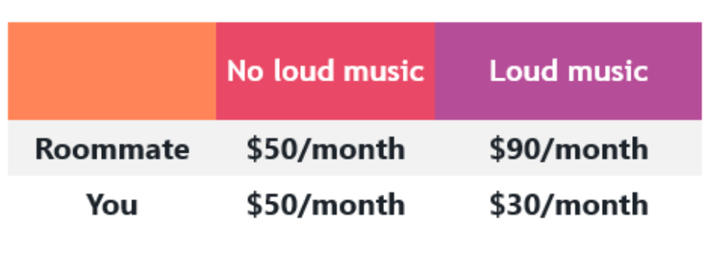
TPS: Coase Example
Which is the socially optimal outcome?
Loud music
What’s the maximum amount you are willing to pay your roommate to stop playing music? (Assume your roommate has the legal right to play music. Negotiation is costless.)
What’s the minimum amount your roommate is willing to accept to stop playing music?
What’s one possible solution?
1
Suppose your roommate likes to
play loud music, but it disturbs you.
The table below reflects your happiness in both scenarios
2
-3
4

Slide 22
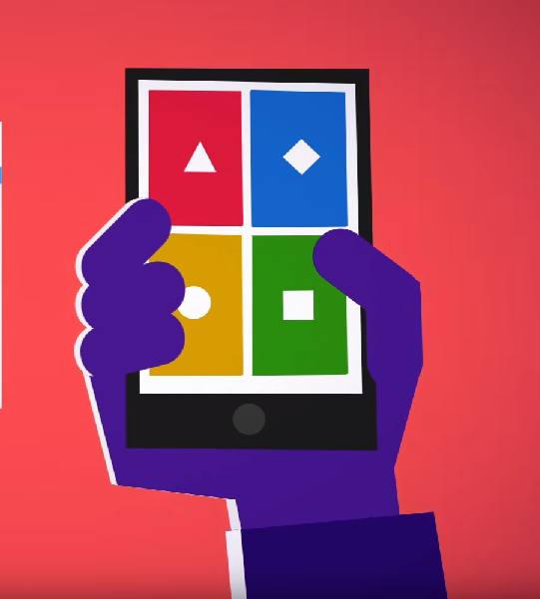
Launch the Kahoot! app or go to Kahoot.it to play the challenge.
!
For your Kahoot! nickname, use your EID. You must do this to earn participation points.
!
!
Points are earned for correct answers, not speed.

Slide 23
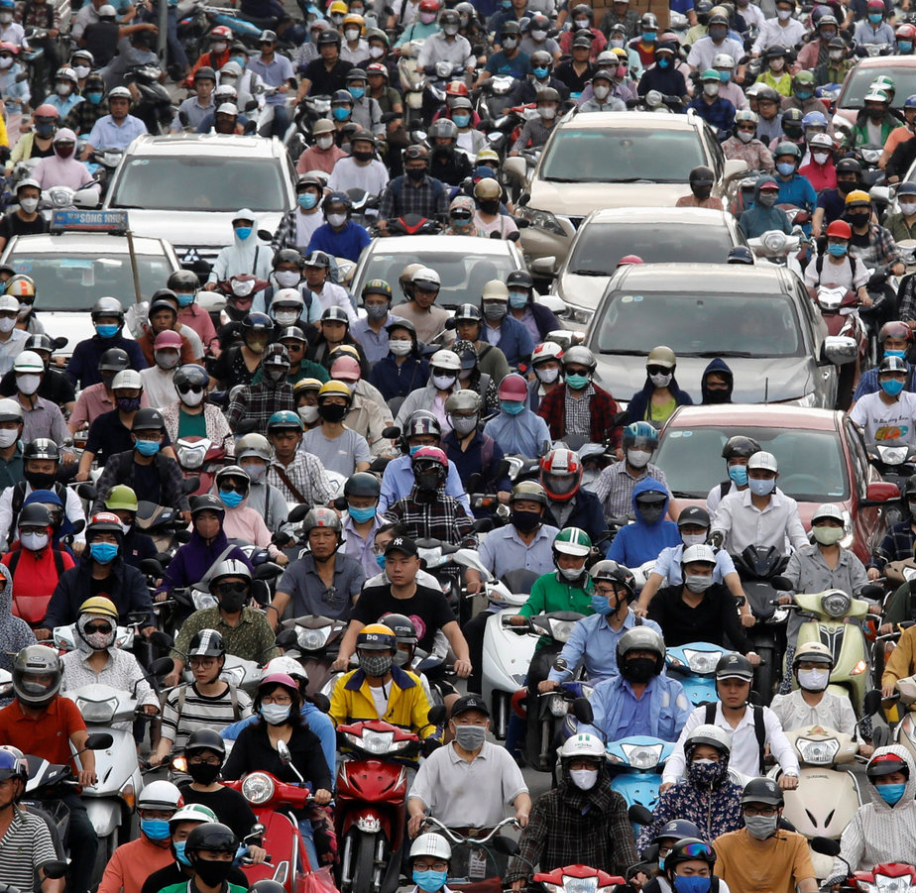
Definitions
Non-rival: one person enjoying the good does not keep others from enjoying it
Non-excludable: once a resource is provided, even those who fail to pay for it cannot be excluded from enjoying its benefits

Slide 24
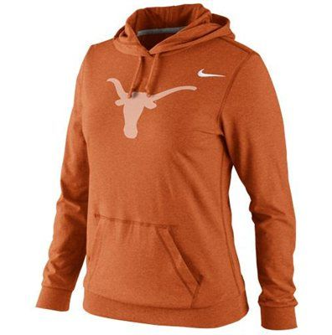
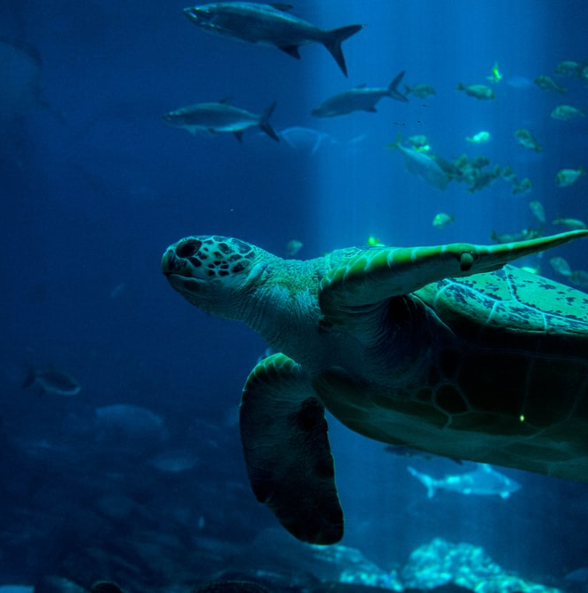
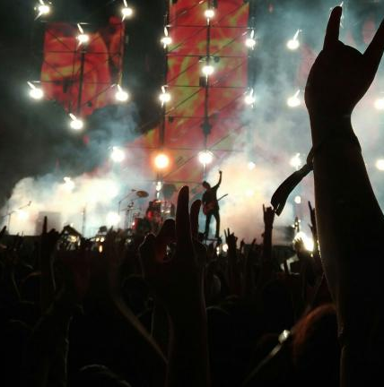
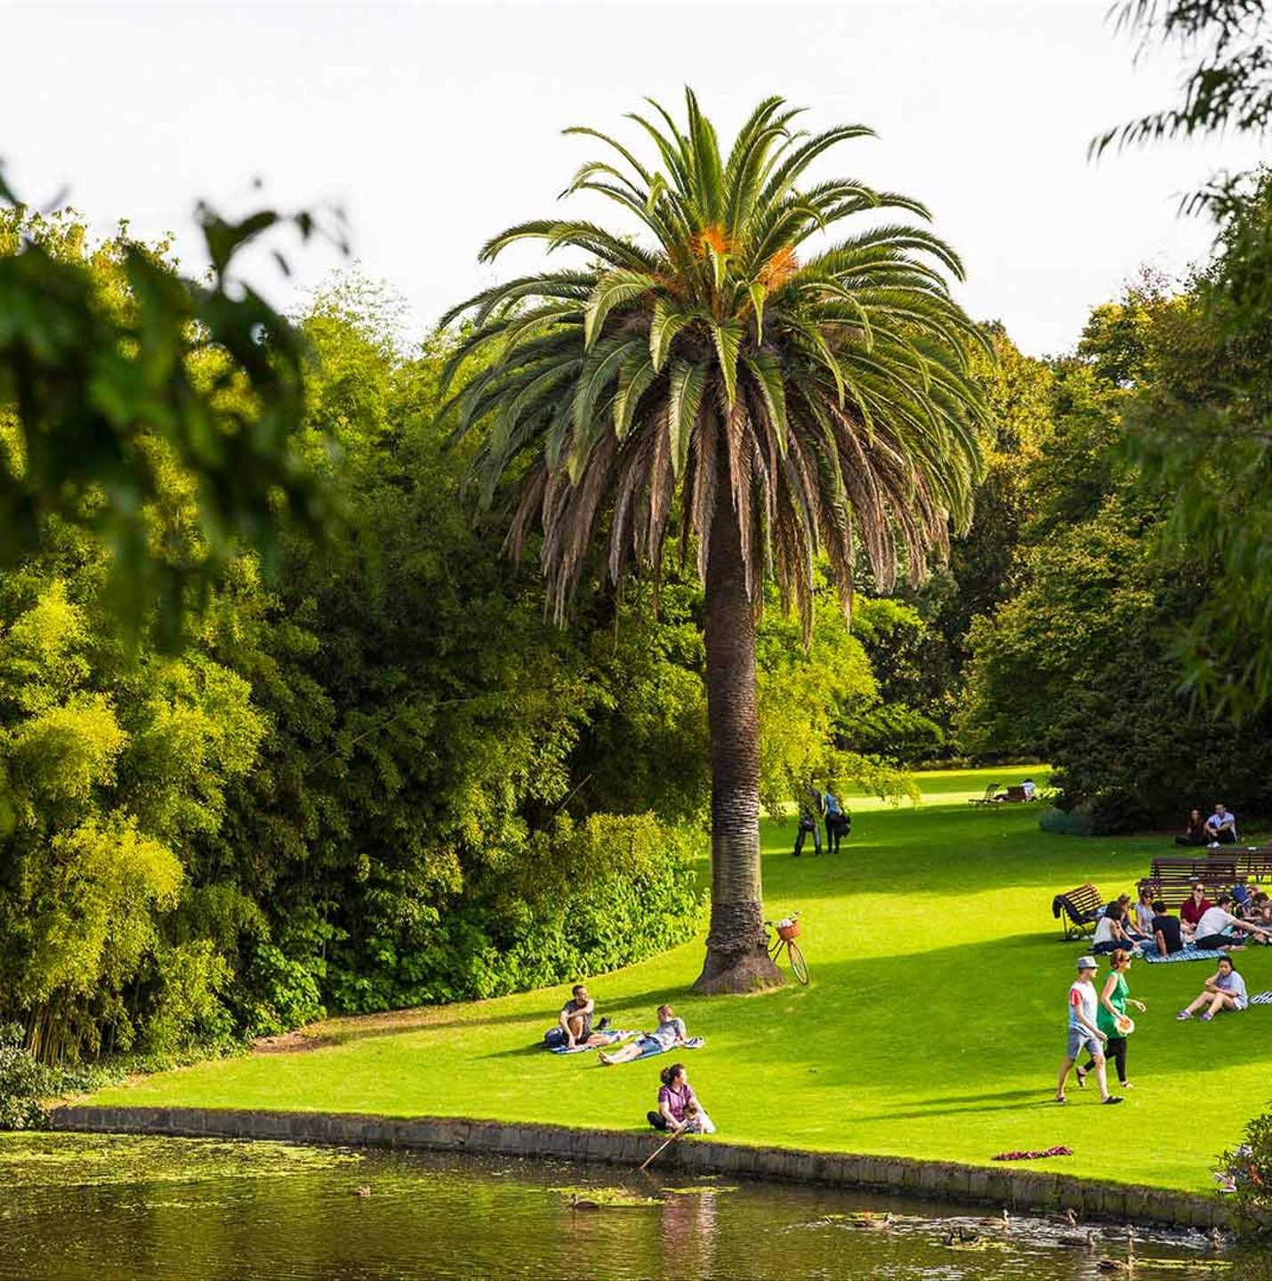
Four Types of Goods
Private Good
Common Resource
Excludable
Rival
Not Excludable
Rival
Club Good
Public Good
Excludable
Not Rival
Not Excludable
Not Rival

